Slide 1
AWS Guard Duty Azure Security Center
AWS Guard Duty & Azure Security Center
V1.1 Jul-21

Slide 2
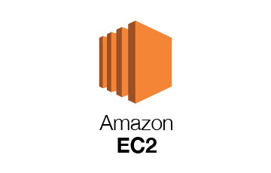
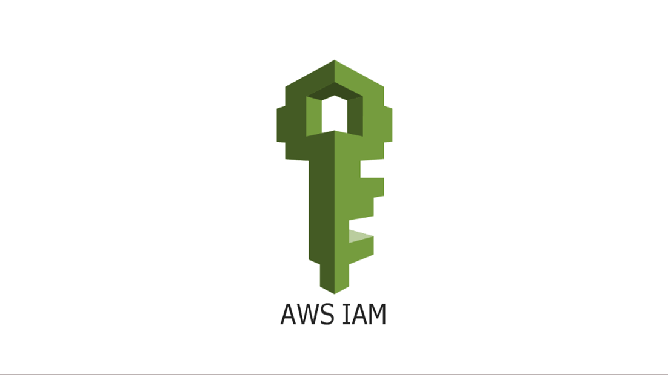
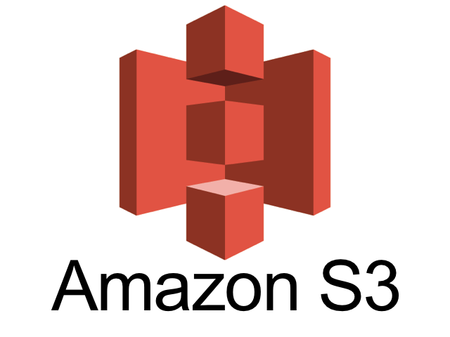
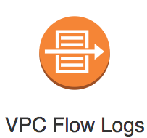
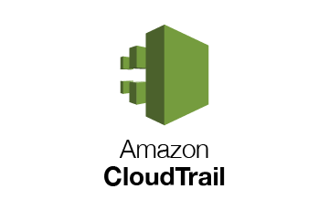

AWS Guard Duty
AWS DNS logs
https://docs.aws.amazon.com/guardduty/latest/ug/guardduty_data-sources.html

Slide 3
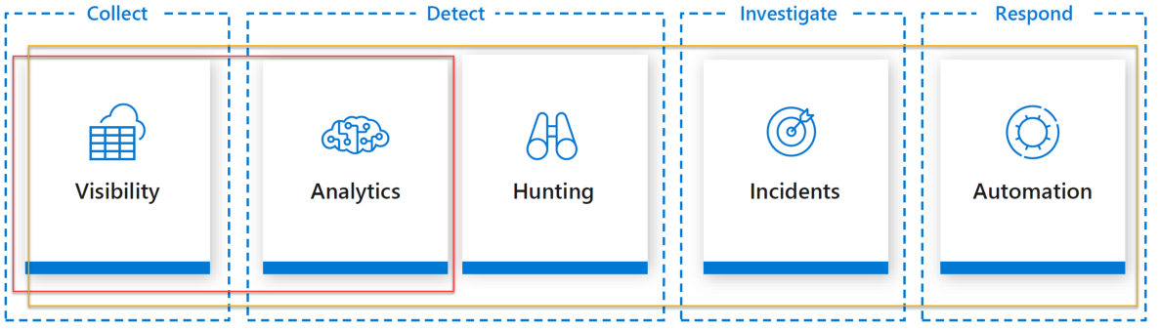
Cybersecurity Cycle
Typical Security Operations Center (SOC)

Slide 4
AWS Guard Duty AWS Security Hub Azure Defender Azure Security Center

Slide 5
Cloud Workload
Virtual Machines
Containers
Serverless .

Slide 6
Prisma Cloud
Prisma Cloud is a cloud infrastructure security solution and a Security Operations Center (SOC) tool that enables you to address risks and secure your workloads in a heterogeneous environment (hybrid and multi-cloud) from a single console.

Slide 7
Prisma Cloud
Resource configurations, user activity, network traffic logs, and host activity and vulnerabilities data is ingested into Prisma Cloud though the public cloud APIs.
Dynamically discovers resources that are deployed in the cloud and tracks historical changes to those resources for auditing and forensics purposes. ? Q how using which id?
Provides visibility, detection, and response to security threats to your public cloud accounts.
Provide you a comprehensive cloud Configuration Management Database, the data you need for compliance reporting and to address compliance violations, threat detection and response, and data security.
Integrate with additional third-party applications for outbound alert notifications, such as Splunk, Jira, and many others.
Recommended Browser is Chrome

Slide 8
Why Prisma Cloud
Health status of all clouds in single pane
If Compute Tab is not visible means you are not Admin
Role ARN include AWS Id
One Cloud Account can be added to Multiple Account Groups

Slide 9
Administrator Roles- Prisma Cloud
System Admin
Account Group Admin
Account Group Read Only
Cloud Provisioning Admin
Account & CP Admin
Build & Deploy Security Role

Slide 10
Threat
Person or Process that can exploit a vulnerability intentionally or accidently to damage, destroy an Asset

Slide 11
Vulnerability
Weakness or gap in a security program that can be exploited by Threats to gain unauthorized access to an Asset

Slide 12
Risk
The potential for loss, damage and destruction of an asset as a result of Threat exploiting a Vulnerability

Slide 13
Policy- Prisma Cloud
Prisma cloud has 4 types of Policy:
Config
Audit Event
Network
Anomaly
Policy is created in Disabled state by default

Slide 14
Alert State- Prisma Cloud
Prisma cloud has 4 types of Alert State:
Open
Snoozed
Dismissed
Resolved
An alert is an event tied to one or more policies that has been incorporated into an alert rule.
Anomaly alerts are not based on RQL but are based on machine learning. Anomaly alerts cannot be cloned or modified directly.

Slide 15
Shared Responsibility Model
Data Classification & Accountability
Client & endpoint protection
Identity & access management
Application level controls
Network controls
Host infrastructure
Physical security

Slide 16
Antimalware
The pot

Slide 17
AWS Security Hub
AWS Security Hub gives you a comprehensive view of your security alerts and security posture across your AWS accounts.
With Security Hub, you now have a single place that aggregates, organizes, and prioritizes your security alerts, or findings, from multiple AWS services, such as Amazon GuardDuty, Amazon Inspector, Amazon Macie, AWS Identity and Access Management (IAM) Access Analyzer, AWS Systems Manager, and AWS Firewall Manager, as well as from AWS Partner Network (APN) solutions.
AWS Security Hub continuously monitors your environment using automated security checks based on the AWS best practices and industry standards that your organization follows.
You can also take action on these security findings by investigating them in Amazon Detective or by using Amazon CloudWatch Event rules to send the findings to ticketing, chat, Security Information and Event Management (SIEM), Security Orchestration Automation and Response (SOAR), and incident management tools or to custom remediation playbooks. Get started with AWS Security Hub in just a few clicks in the Management Console and once enabled, Security Hub will begin aggregating and prioritizing findings and conducting security checks.

Slide 18
AWS Security Hub –Use cases
Amazon GuardDuty Integrations
Amazon Inspector for out bound integration,
Amazon Macie In bound Integration
AWS Identity and Access Management (IAM) Access Analyzer Inbound Integration
AWS Systems Manager integration,
AWS Firewall Manager integration

Slide 19
AWS GuardDuty – Use case
Monitor and protect their AWS accounts, workloads, and data stored in Amazon S3
AWS CloudTrail Management Events (AWS user and API activity ), AWS CloudTrail S3 Data Events ( S3 activity), Amazon VPC Flow Logs, and DNS Logs.
Account compromise. Example include:
Access of AWS resources from an unusual geo-location at an atypical time of day.
Checks for unusual API calls, such as attempts to obscure account activity by disabling CloudTrail logging or
Taking snapshots of a database from a malicious IP address.
Instance compromise. Example include:
Cryptocurrency mining,
Backdoor command and control (C&C) activity,
Malware using domain generation algorithms (DGA),
Outbound denial of service activity, unusually high volume of network traffic, unusual network protocols, outbound instance communication with a known malicious IP, temporary Amazon EC2 credentials used by an external IP address, and
Data exfiltration using DNS.

Slide 20
AWS GuardDuty – Use case
Malicious reconnaissance. Example include:
API calls from an unusual geolocation or anonymizing proxy,
Attempts to disable AWS CloudTrail logging, Changes that weaken the account password policy
Unusual instance or infrastructure launches,
Infrastructure deployments in an unusual region, and
API calls from known malicious IP addresses.
Bucket compromise. Example include:
Suspicious data access patterns indicating credential misuse,
Unusual S3 API activity from a remote host,
Unauthorized S3 access from known malicious IP addresses, and
API calls to retrieve data in S3 buckets from user that had no prior history of accessing the bucket or invoked from an unusual location.

Slide 21
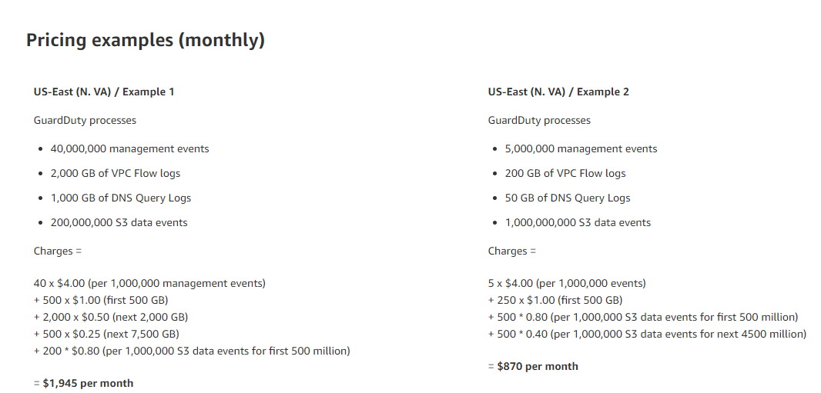
AWS Guard Duty (cost)
Price in each region would be different.

Slide 22
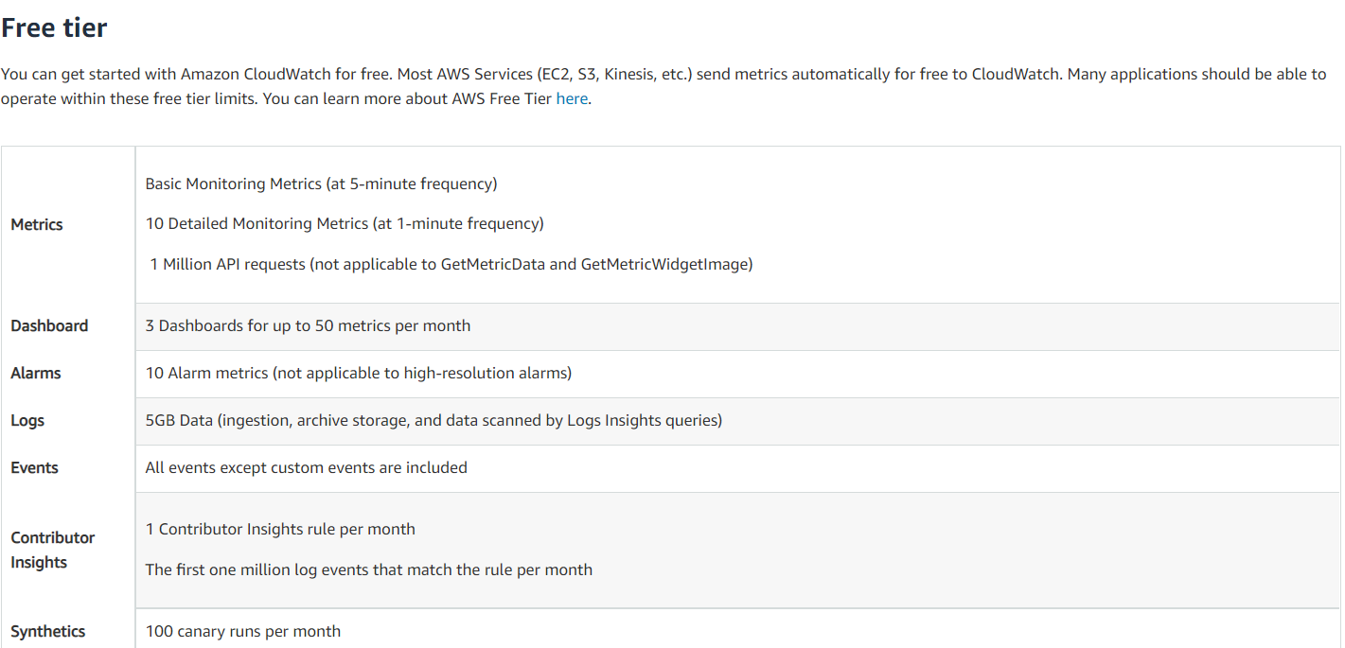
AWS CloudWatch (Cost Calculation) – Free Tier
No up front or minimum fee
Pay what you use

Slide 23
AWS CloudWatch (Cost) – Paid Tier
GetMetricData: Number of metrics requested
GetMetricData: Number of metrics requested
No up front or minimum fee
Pay what you use
Billing at the end of the month
Amazon CloudWatch Pricing – Amazon Web Services (AWS)
Metrics
Number of Metrics (includes detailed and custom metrics)
APIs
GetMetricData: Number of metrics requested
GetMetricWidgetImage: Number of metrics requested
Number of other API requests
GetMetricStatistics, ListMetrics, PutMetricData, GetDashboard, ListDashboards, PutDashboard and DeleteDashboards requests are the other request types which are billed at the same price.
Logs
Standard Logs: Data Ingested in GB
Vended Logs: Data Ingested
VPC and Route53 logs qualify for Vended Logs pricing.
Log Storage/Archival (Standard and Vended Logs)
Log volume archived is estimated to be 15% of Log volume ingested (due to compression). Storage/Archival costs are estimated assuming customer choses a retention period of one (1) month. Default retention setting is ‘never expire’. ( assuming 1 month retention)
Logs Delivered to S3: Data Ingested
VPC flow logs and Global Accelerator flow logs also qualify for this pricing.
Logs Insights Queries (Analyse Log Data)
Expected Logs Data scanned
Events
Number of Custom/Cross-account events
Dashboards and Alarms
Number of Dashboard
Number of Standard Resolution Alarm Metrics
Standard Resolution Alarms (60 seconds).
Number of High Resolution Alarm Metrics
High Resolution Alarm (10 seconds).
Number of composite alarms
Composite alarms can combine any type of CloudWatch alarm. Metric alarms are billed based on the number of metrics per alarm, while composite alarms are billed per alarm unit.
Canaries
Number of Canary runs
Contributor Insights for CloudWatch Logs
Number of Contributor Insights rules for CloudWatch
Total number of matched log events for CloudWatch
Contributor Insights for DynamoDB
Number of Contributor Insights rules for DynamoDB
Total number of events for DynamoDB
Lambda Insights
Number of Lambda functions
Number of requests per function

Slide 24
AWS CloudTrail (Cost Calculation) – Free Tier

Slide 25
AWS CloudTrail (Cost Calculation) – Paid Tier

Slide 26
AWS Security Hub (cost)
2 pricing dimensions for Security Hub:
Number of security checks per account/region/month
First 100,000 Checks | $0.001
Next 400,000 Checks | $0.0008
Above 500,000 Checks | $0.0005
Number of finding ingestion events per account/region/month
Perpetual Tier of 10000 | Free
After the first 10,000 | $0.00003
Customers are not charged for finding ingestion events generated by Security Hub’s security checks

Slide 27
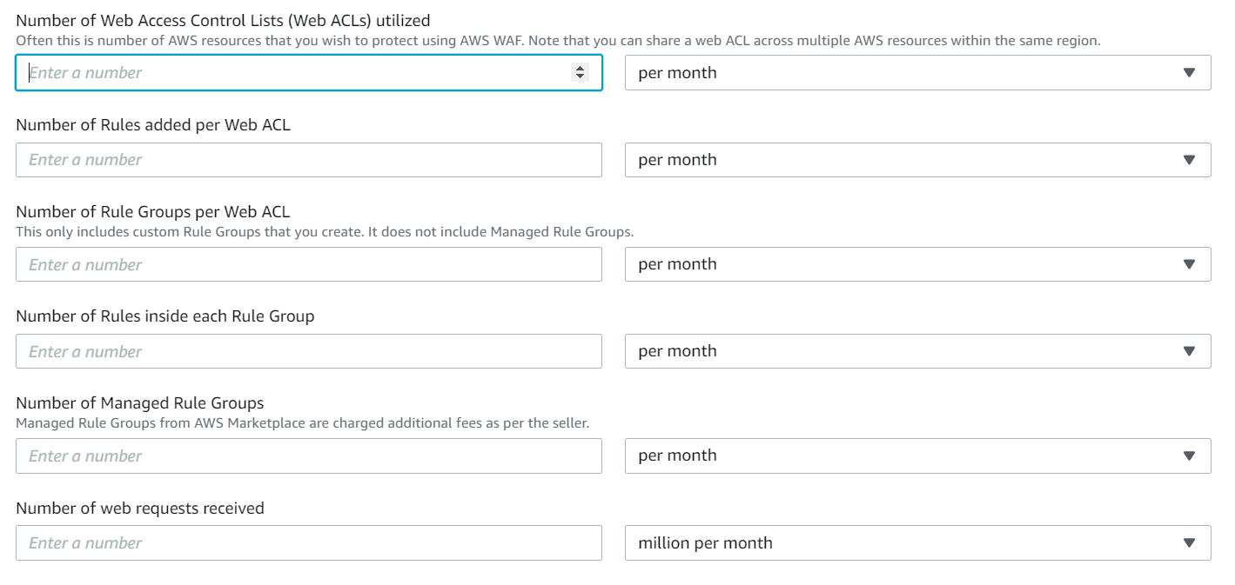
AWS WAF (cost)
Pricing - AWS WAF - Amazon Web Services (AWS)

Slide 28
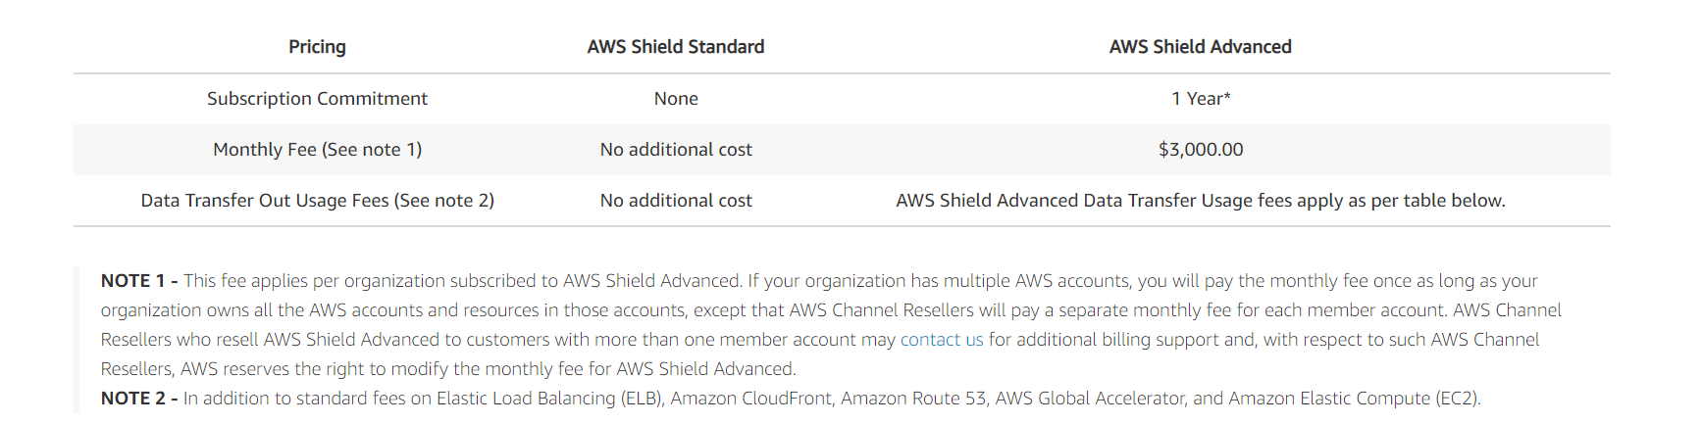
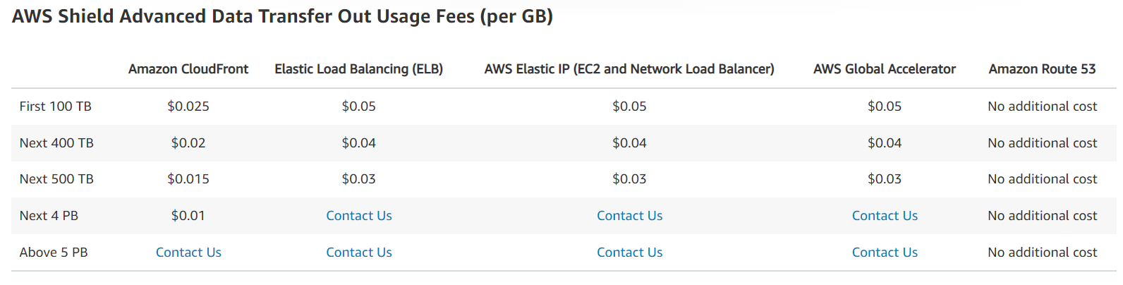
AWS Shield (cost)

Slide 29
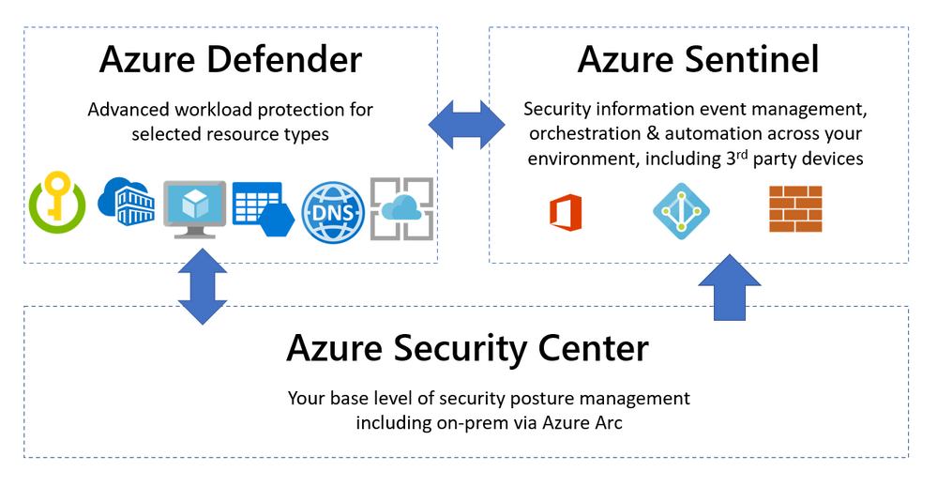
Azure Security Center
https://query.prod.cms.rt.microsoft.com/cms/api/am/binary/RE4s2L2
Azure Security Center provides unified security management and advanced threat protection across hybrid cloud workloads (both azure based, inhouse resources).

Slide 30
Azure Security Center – Use Case
Strengthen security posture:
Security Center assesses environment and enables to understand the status of resources(whether they are secure)
Protect against threats
Security Center assesses workloads and raises threat prevention recommendations and security alerts
Cloud workload protection (CWP)

Slide 31
Azure Defender
Azure Defender. Is configured to add additional security alerts and advanced threat detection for certain types of resources.
Available for servers, app service, Storage, SQL, Key Vault, Resource Manager, DNS, Kubernetes and container registries

Slide 32
Azure Defender ( Services covered)
Services Covered:
Servers
App Service
SQL on Azure
SQL outside Azure
MySQL
PostgreSQL
MariaDB
Storage - Protect all storage accounts within a subscription1 10K transactions
Kubernetes vCore/hour
ACR /image
Key Vault /10K transactions
ARM /1M API calls
DNS

Slide 33
Azure Defender ( Services covered)
Services Covered:
Servers
App Service
SQL on Azure
SQL outside Azure
MySQL
PostgreSQL
MariaDB
Storage - Protect all storage accounts within a subscription1 10K transactions
Kubernetes vCore/hour
ACR /image
Key Vault /10K transactions
ARM /1M API calls
DNS

Slide 34
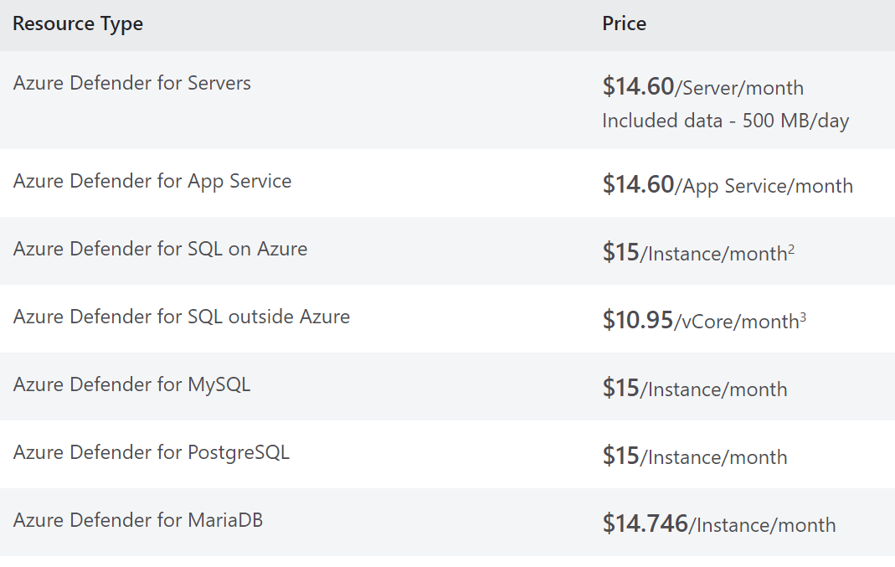
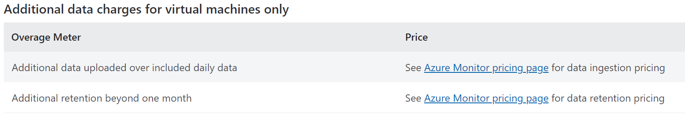
Azure Security Center (cost)
Azure Security Center has 2 offerings:
Azure Security Center free
Azure Defender
If you enable Azure Defender for subscription, all resources would be part of Pricing.
To enable it for certain resources in a resource type enable it through workspace
Pricing across regions are almost similar with very small variation.
Pricing is bases on Resource type:
Pricing—Azure Defender | Microsoft Azure

Slide 35
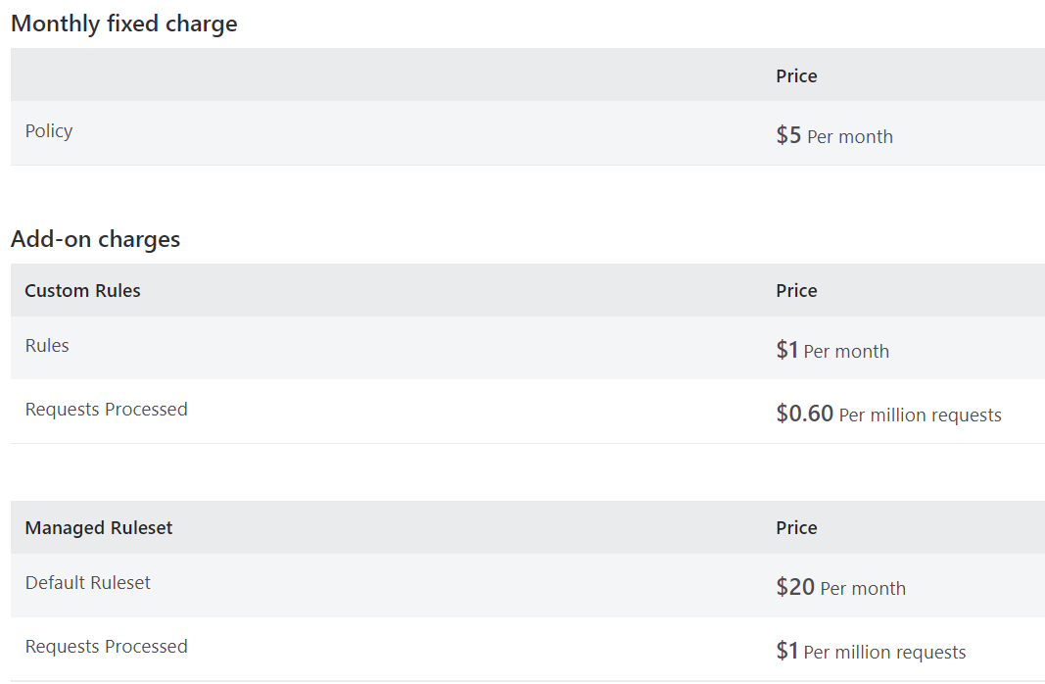
Azure WAF
Azure Web Application Firewall protects your web applications from bot attacks and common web vulnerabilities such as SQL injection and cross-site scripting.
WAF pricing includes:
Monthly fixed charges and
Request based processing charges.
Monthly charge for each policy and
Add-on charges for Custom Rules and Managed Rulesets as configured in the policy.

Slide 36
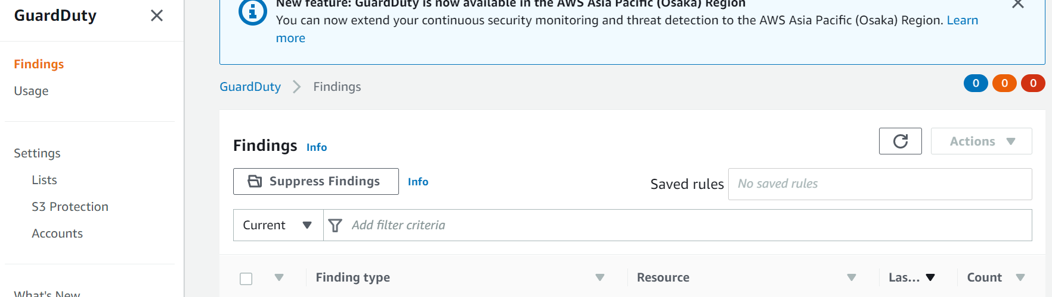
Configuration- AWS GuardDuty

Slide 37
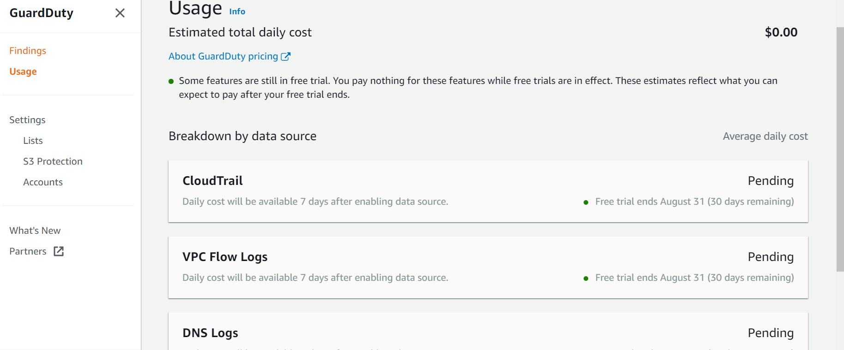
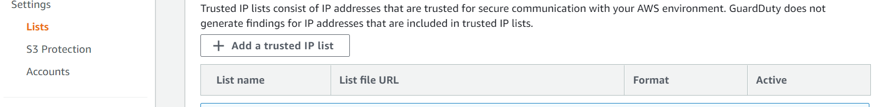
Configuration- AWS GuardDuty

Slide 38
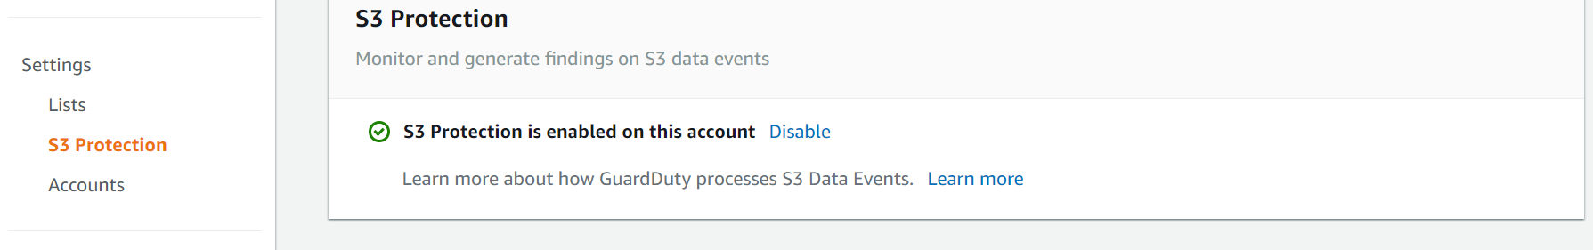
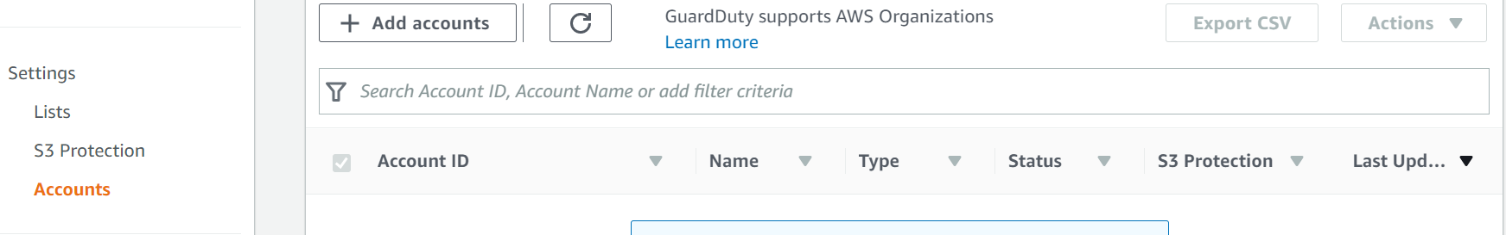
Configuration- AWS GuardDuty

Slide 39
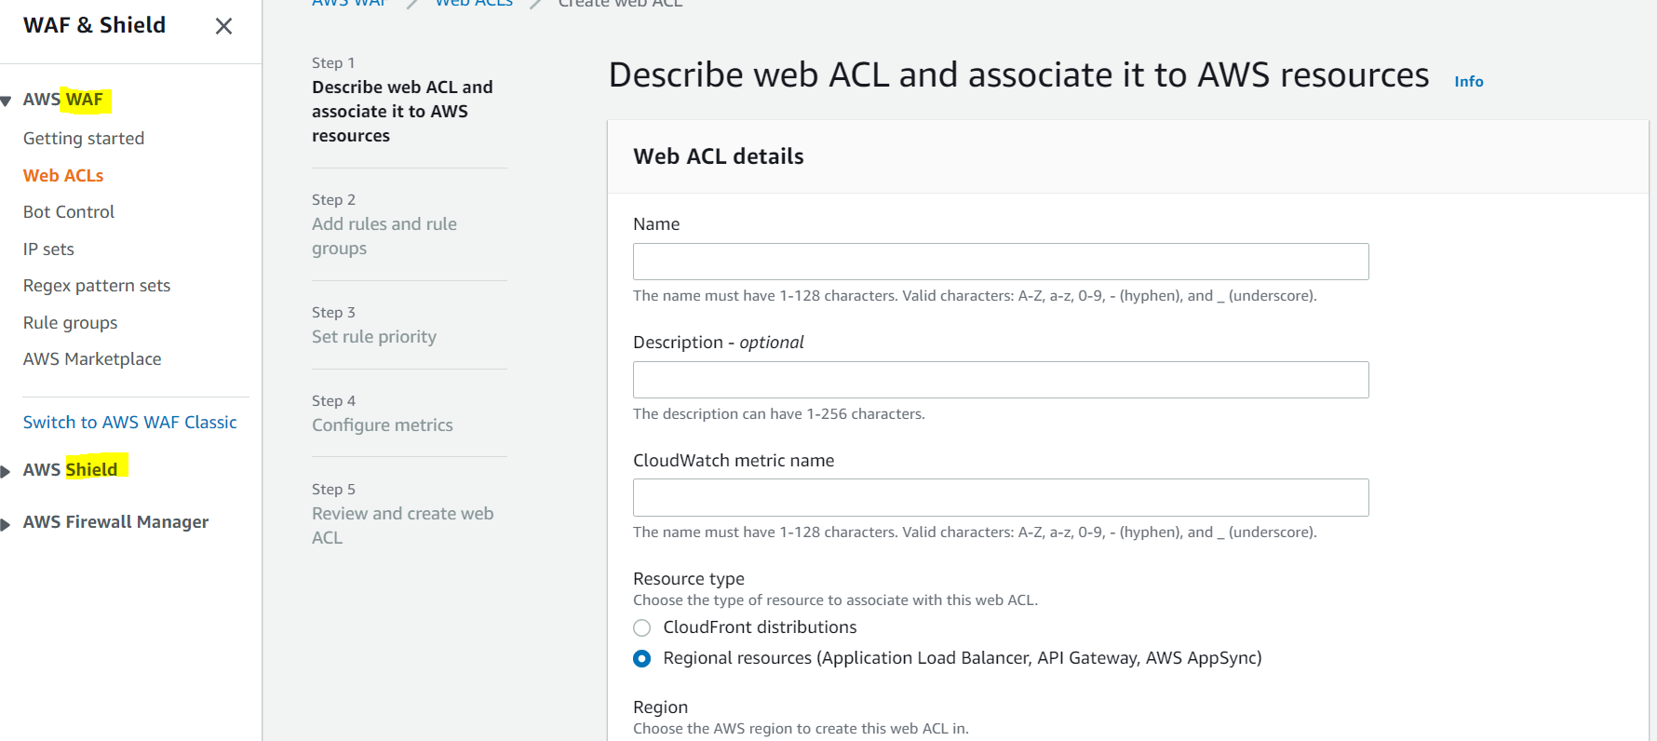
Configuration- AWS WAF

Slide 40
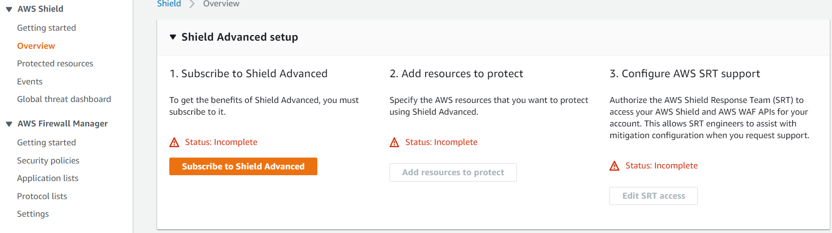
Configuration- AWS Shield

Slide 41
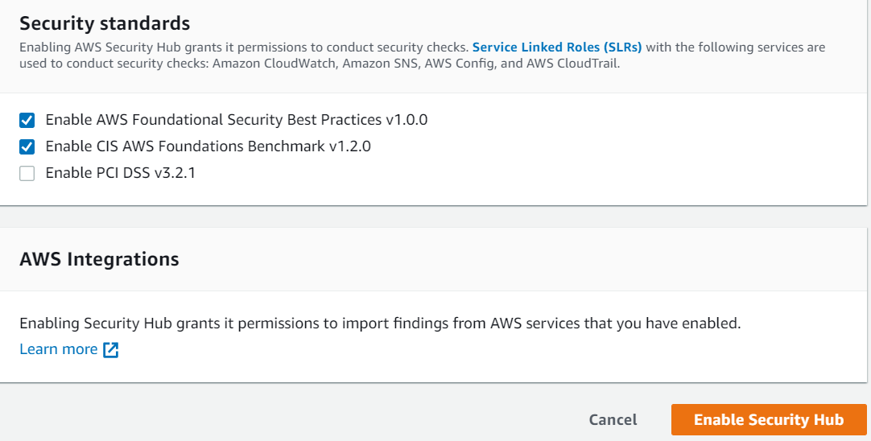
Configuration- AWS Security Hub

Slide 42
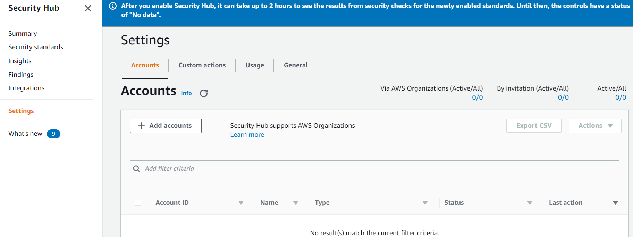
Configuration- AWS Security Hub

Slide 43
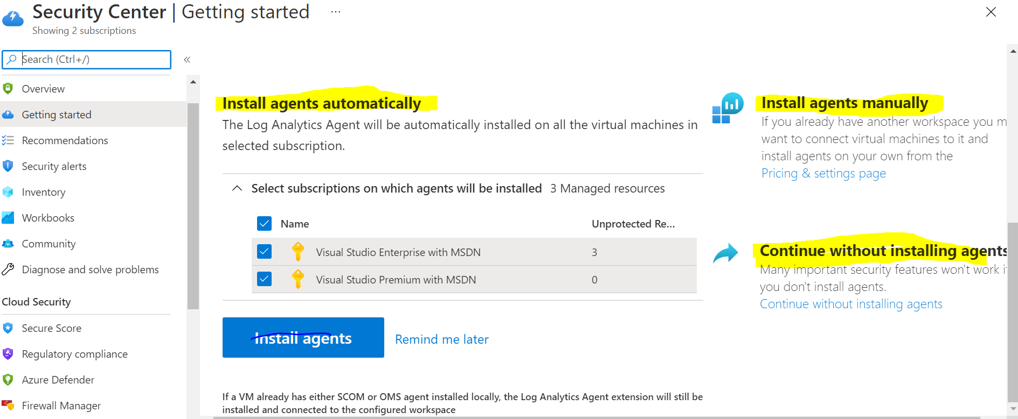
Configuration- Azure Security Center

Slide 44
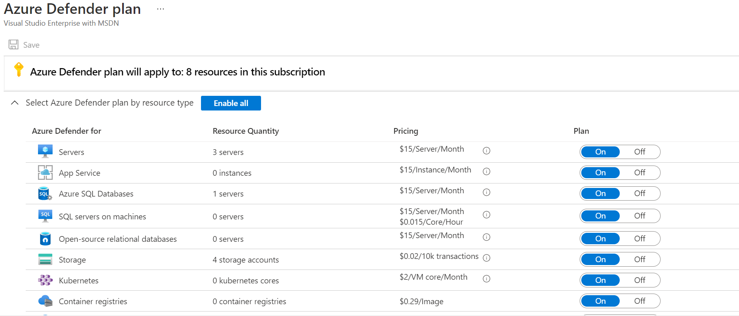
Configuration- Azure Security Centre

Slide 45
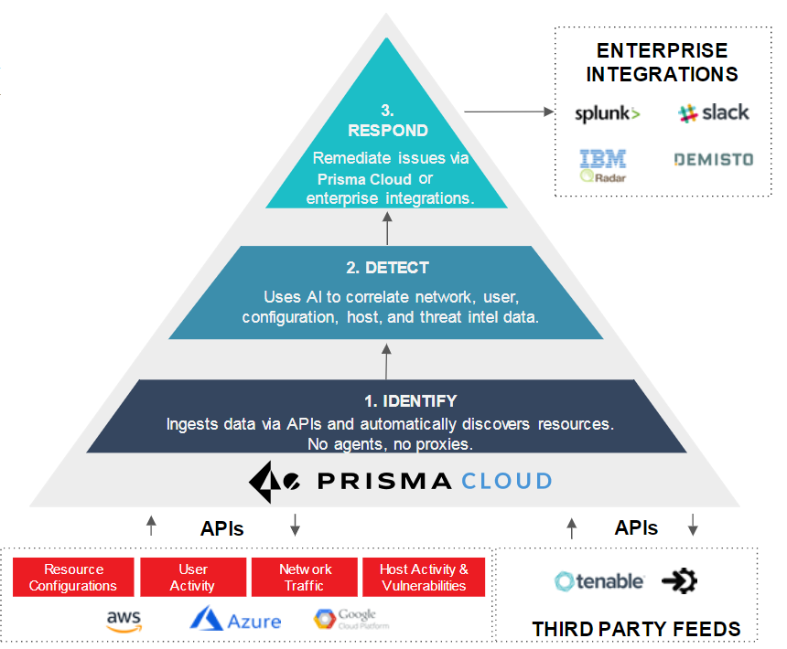
Prisma Capability

Slide 46

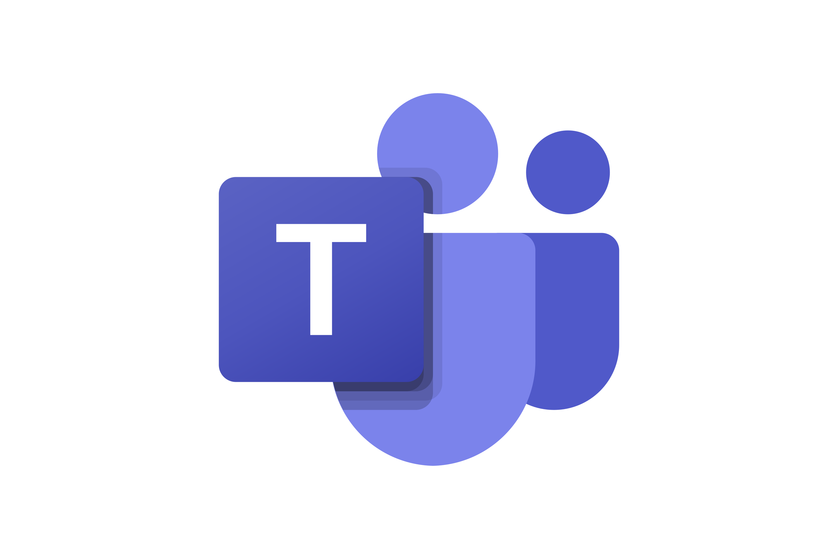

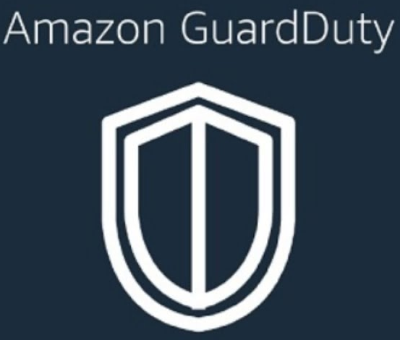



Prisma SIEM Architecture for Allied Materials
Cloud CMDB
Compliance Reporting
Threat Detection & Response
Data Security
Outbound Integration
Custom Reports
VISIBILITY, DETECTION, AND RESPONSE
CUSTOM ALERT RULES, CUSTOM POLICY
DATA COLLECTION & AGGREGATION
API
API
Resource Configuration
User Activity
Network Traffic
Host Activity & Vulnerabilities
VPC Logs, CloudTrail, CloudWatch, Config
Inbound Integration

Slide 47
Pricing for Prisma SAAS
Prisma Cloud Units can be bought in increments of 100 Units.
you estimate the number of units you need to monitor and protect. Your usage data is based on the number of capacity units that you are consuming for each Prisma Cloud module every hour, and the Time Range is averaged for daily, weekly, monthly and quarterly usage to prevent overages based on short-term bursts.
The Visibility, Compliance & Governance Module costs one credit per resource instance (e.g., Amazon EC2).
The Host Security Module costs one credit per Host Defender, and Container Security costs seven credits per Container Defender

Slide 48
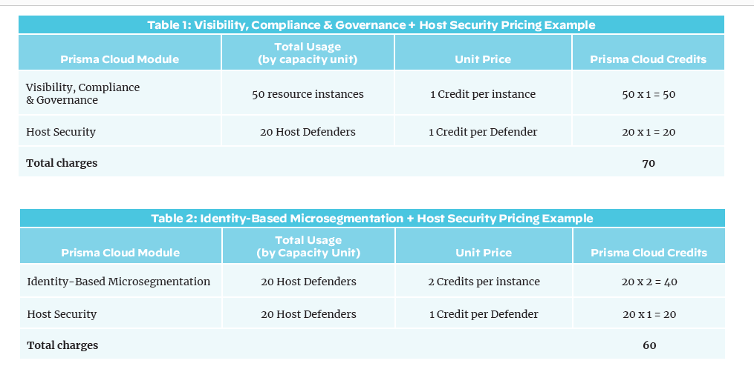

Slide 49
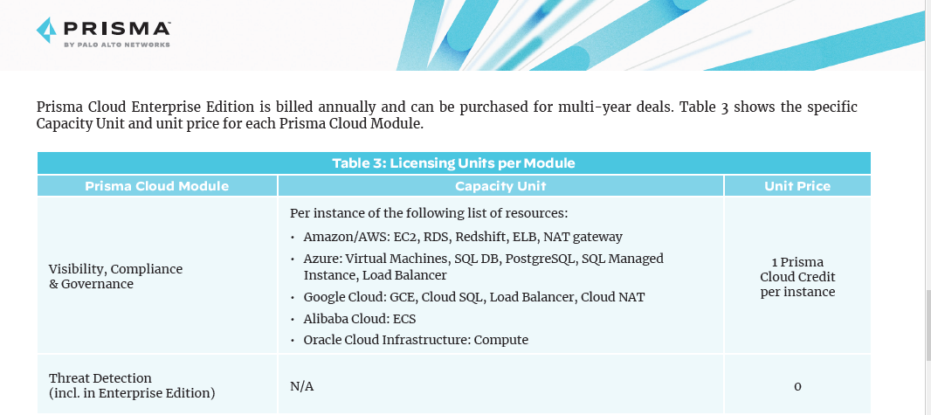

Slide 50
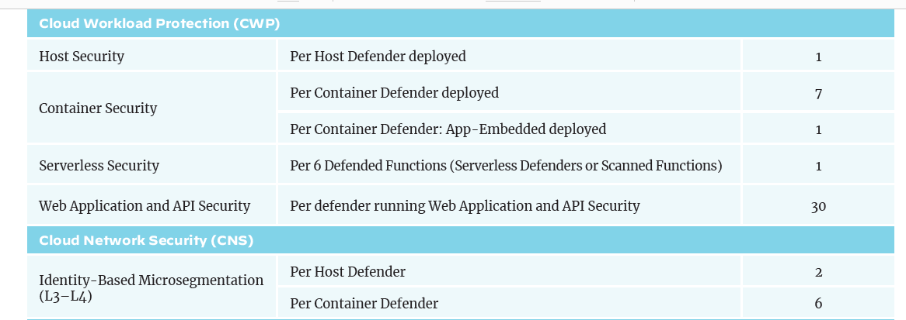

Slide 51
Prisma- Defender Types
Defender types:
Container Defender ( Linux , Windows)
Host Defender ( Linux, Windows)
Fargate Defender
Serverless Defender ( Embedded inside functions)
App Embedded

Slide 52
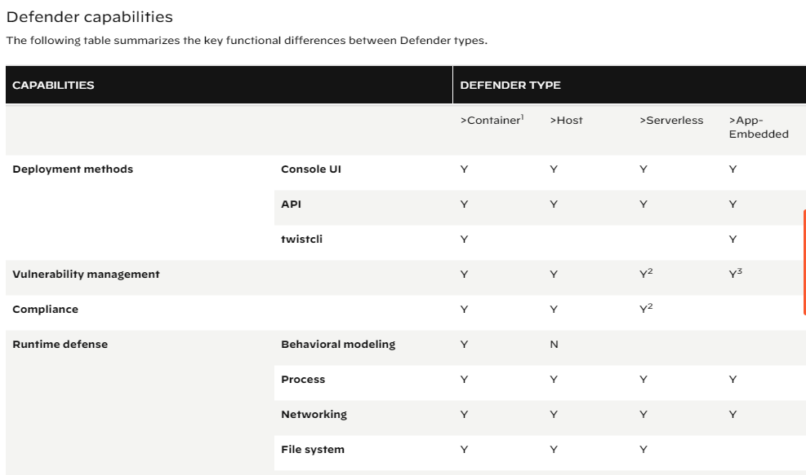
Prisma – Defender Capability

Slide 53
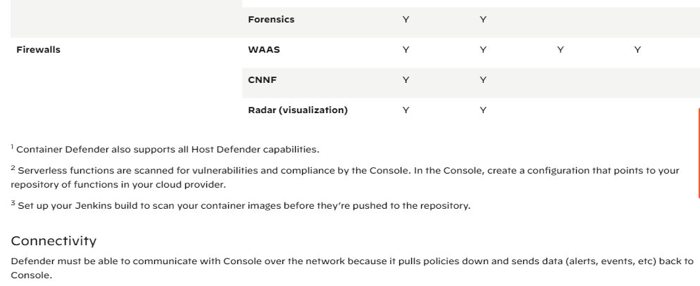
Prisma – Defender Capability
WAAS: Web Application and API security

Slide 54
Prisma- Use Case- AWS Host
Detection for:
Malware
Network
Log inspection
File integrity
Activities and custom events
Host protection has all capability. This is continuously reporting/ up-to-date context for your hosts.
https://docs.paloaltonetworks.com/prisma/prisma-cloud/prisma-cloud-admin-compute/runtime_defense/runtime_defense_hosts.html

Slide 55
Prisma- Use Case- AWS Fargate
Verification of launched processes
Verification of domain name resolution, and inbound and outbound network connections.

Slide 56
Prisma- Use Case- AWS Containers
Predictive protection capabilities like determining when a container runs a process not included in the origin image or creates an unexpected network socket.
Threat based protection capabilities like detecting when malware is added to a container or when a container connects to a botnet.

Slide 57
Prisma- Use Case- AWS Data Security
Prisma Cloud Data Security
Supports Monitor mode only.
Do not support automatic remediation
You must manually fix issues to address alerts generated from Data policies.

Slide 58
Prisma- Use Case- Azure Services (using API)
Microsoft Azure APIs Ingested by Prisma Cloud (paloaltonetworks.com)
Services covered by API Ingestion:
Azure Application Gateway, Azure Active Directory, Azure API Management, Azure Cache, Azure Compute
Azure Cosmos DB, Azure Data Bricks, Azure Database for MySQL, Azure Data Factory, Azure Data Lake Analytics
Azure Data Lake Storage (Gen 1), Azure Event Hubs, Azure Key Vault, Azure Load Balancer, Azure Logic Apps
Azure Resource Group, Azure Resource Manager, Azure Policy, Azure Security Center, Azure Virtual Network
Azure SQL Database, Azure Database for PostgreSQL, Azure Monitor, Azure Network Watcher
Azure Storage, Subnets, Azure Kubernetes Service, App Service, Azure VPN Gateway

Slide 59
Prisma- Twistcli – Build Process
Twistlock:
Scans all of the images in the registry,
Scans images during the build and deploy process,
And also continuously monitors any vulnerability changes in your running containers.
Twistlock generates a risk score for each of the vulnerabilities it find
Use risk metrics like CVSS
Also a whole host of other metrics as well
Is this container connected to the internet?
Does it have open listening ports?
Does it have a security profile attached

Slide 60
AWS Multiple accounts
Benefits:
Rapid innovation with various requirements: Accounts can be allocated to teams, workloads, or products. Separate accounts can provide custom environments and accommodate the differing security needs for each team.
Simplified billing: The use of multiple accounts simplifies how you allocate AWS costs. You can use them to identify which projects or services are responsible for AWS charges.
Flexible security controls: You can create grouping mechanisms to ensure certain accounts meet compliance requirements, such as HIPAA or PCI DSS.
Easily adapt to business processes: The use of multiple accounts allows you to set up your IT infrastructure in a way that reflects the needs of your business processes or requirements.

Slide 61
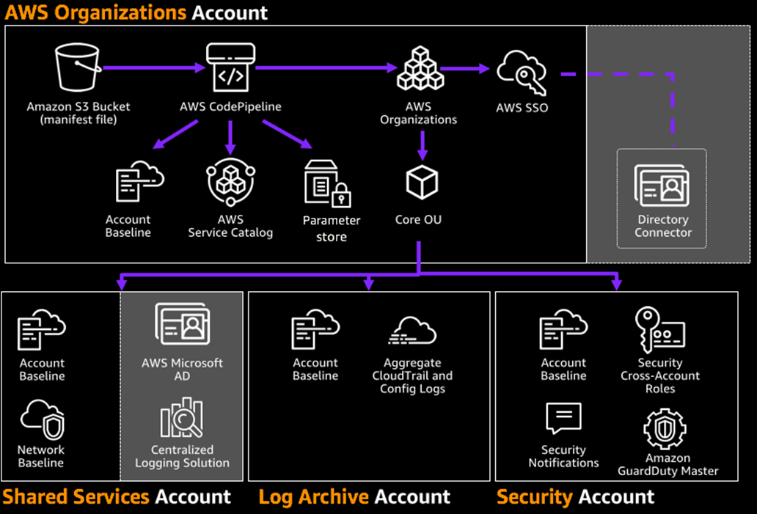
AWS Multiple accounts

Slide 62
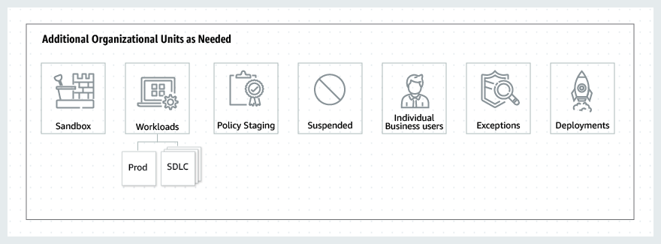
AWS Multiple accounts
Best Practices for Organizational Units with AWS Organizations | AWS Management & Governance Blog (amazon.com)

Slide 63
Reference:
https://www.paloaltonetworks.com/resources/guides/prisma-cloud-enterprise-edition-licensing-guide.

